Slide 1
Hive plots- rational approach to visualizing networks
It is an article from "Briefings in Bioinformatics" introducing hive plots as a novel approach to visualizing networks, particularly in the context of bioinformatics and systems biology.
Martin Krzywinski, Inanc Birol, Steven J.M. Jones and Marco A. Marra in 2011

Slide 2
Introduction
Hive plots present a novel method for visualizing complex networks.
Traditional network visualization techniques, such as force-based or spectral layouts, often suffer from lack of reproducibility and perceptual uniformity, making them difficult to interpret and compare.
Hive plots address these issues by providing a structured and reproducible way to visualize networks.

Slide 3
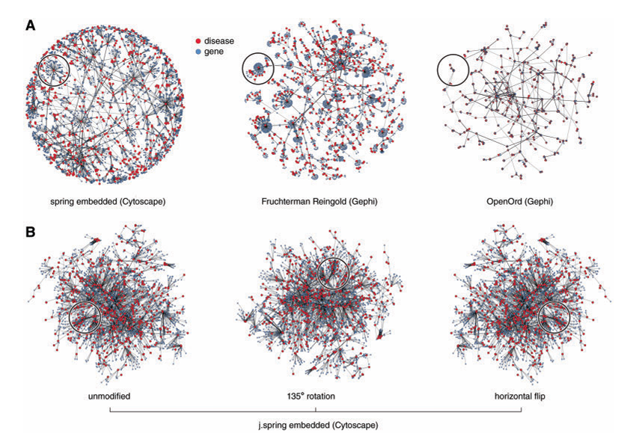
Challenges in Traditional Network Visualization:
Traditional methods like force-based layouts are often unpredictable and can produce widely varying visual representations for the same network depending on initial conditions.
Such visualizations can be difficult to interpret and compare, especially when networks are large and complex.

Slide 4
Introduction to Hive Plots:
Concept: Hive plots arrange nodes on radially oriented linear axes based on their structural properties, creating a visual that resembles a bee hive.
Components: The layout is defined by three flexible components:
1. rules for node assignment to axes
2. layout profiles of axes
3. rules for edge formatting.

Slide 5
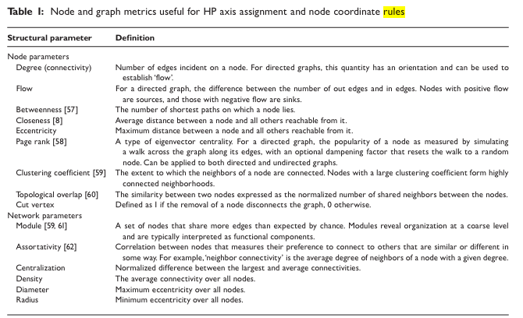

Slide 6
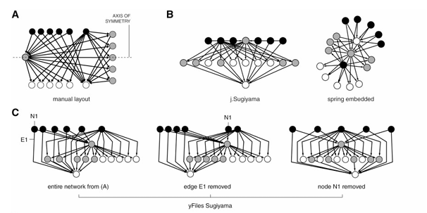
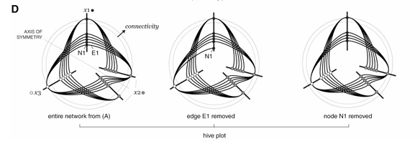
Directed Undirected
rendered as a parallel-coordinate plot The assignment of nodes to the x1, x2 and x3 axes is based on the directionality of edges and node coordinates are a function of connectivity (total number of edges)
axis assignment can be based on a structural quantity, such as the ‘clustering coefficient’ (cc), which characterizes the interconnectivity of a node’s neighbors.

Slide 7
Advantages of Hive Plots:
Rational and Reproducible: Hive plots use a well-defined coordinate system, ensuring that the same network structure always results in the same layout.
Quantitative and Transparent: They provide quantitative visual signatures that are easy to understand and interpret.
Scalability: Hive plots scale well with network size, making them suitable for both small and large networks.
Comparability: The method allows for easy comparison between different networks or different states of the same network by highlighting only the affected parts when changes occur.

Slide 8
Practical Applications:
Network Comparison: Hive plots are particularly useful for comparing different networks or different states of the same network, such as gene regulatory networks or disease networks.
Pattern Detection: They help in identifying patterns like hubs and clusters within the network.

Slide 9
Implementation and Tools:
Hive plots are computationally straightforward and can be integrated into existing visualization tools.
Implementations are available in various programming languages, including Perl and R, making them accessible to researchers.

Slide 10
Conclusion
HPs provide a solution to bridge the gap between assess ing and comparing structures of large networks and studying fine structure of small components of interest.
As a layout algorithm, hive plots can be tuned to answer specific questions of interest to the experimenter.
Finally, they are computationally simpler than traditional layout algorithms and therefore, amenable to responsive interactive interfaces through a plugin

Slide 11
Key points
Key Points Hive plots introduce a rational method of network visualization in which nodes are placed on radial axes, with coordinates determined solely by structural properties of the network.
Hive plots are flexible: node placement rules can be tuned to increase sensitivity to specific patterns.
Hive plots are predictable: for a given set of rules, the same structures always have the same layout.
Hive plots are comparable: differences in layouts is proportional to differences in corresponding networks.
Hive plots are transparent and practical: rational rules make the layout easy to understand, interpret and implement.

